Slide 1
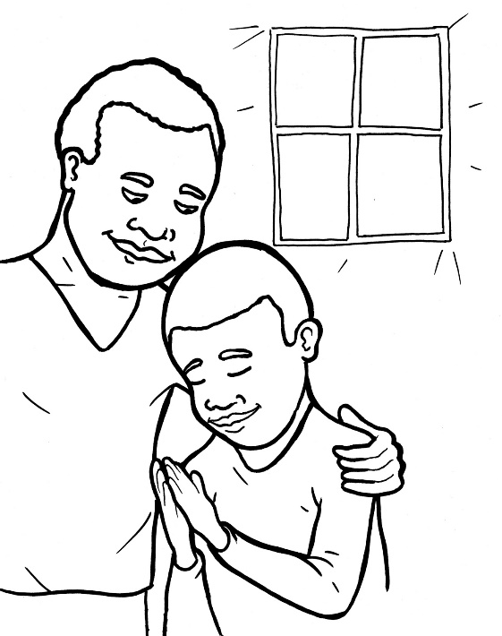

50. I am Alive: Prayer
Part 4
Story in Easy Read English
Questions
Story in Phrases

Slide 2
For a Christian, praying is like air.

Slide 3
It is our breath.

Slide 4
It is our life with God.

Slide 5
He is our best friend and king!

Slide 6
In order to keep a friendship alive, you need to talk to your friend, right?

Slide 7
It is the same with God.

Slide 8
He longs to hear from you.

Slide 9
You are his sweet child.

Slide 10
He is waiting.

Slide 11
Let’s make sure our prayers are not just about us.

Slide 12
Prayers can often sound like this: “Dear God, Give me this.

Slide 13
Give me that. Amen.”

Slide 14
Ouch! God is not our servant.

Slide 15
We are his servants.

Slide 16
Learn to follow this prayer pattern.

Slide 17
It will help you grow into a mighty, praying Christian.

Slide 18
I P-R-A-Y

Slide 19
“I am sorry.” Start by telling God the sins you’ve been doing.

Slide 20
Our honesty opens his ears.

Slide 21
Praise him! Tell him how amazing he is.

Slide 22
Sing him a praise song.

Slide 23
That makes him happy.

Slide 24
Rejoice! Thank him for prayers he answers.

Slide 25
Ask him for help and for what you would like.

Slide 26
He is your Father.

Slide 27
He wants to bless and help you.

Slide 28
Yes. Listen for his voice.
“Yes, God, I want to obey.”

Slide 29
Each and every day, God hears you when you pray.

Slide 30
Question 1
What is prayer?

Slide 31
Question 2
Why is prayer important for you and God?

Slide 32

Question 3
What praise songs do you know?

Slide 33
Question 4
Why is the I P-R-A-Y pattern good to learn?

Slide 34
Prayer
Dear Lord Jesus,
I am sorry for my sins, like not obeying.
Praise to you for being so kind and forgiving.
Rejoice! Thank you for teaching me.
Ask. I am asking you to help me grow in prayer.
Yes. I will obey you. I will pray to you.
Amen

Slide 35
I am Alive: Prayer
Phrased for Fluency

Slide 36
For a Christian,
praying
is like air.

Slide 37
It is
our breath.

Slide 38
It is
our life
with God.

Slide 39
He is
our best friend
and king!

Slide 40
In order
to keep
a friendship
alive,
you need
to talk
to your friend,
right?

Slide 41
It is the same
with God.

Slide 42
He longs
to hear
from you.

Slide 43
You
are his
sweet child.

Slide 44
He is waiting.

Slide 45
Let’s make sure
our prayers
are not
just about us.

Slide 46
Prayers
can often
sound like this:
“Dear God,
Give me this.

Slide 47
Give me that. Amen.”

Slide 48
Ouch!
God is not
our servant.

Slide 49
We are
his servants.

Slide 50
Learn
to follow
this prayer pattern.

Slide 51
It will help
you grow
into a mighty,
praying Christian.

Slide 52
I P-R-A-Y
“I am sorry.”

Slide 53
Start by
telling God the sins
you’ve been doing.

Slide 54
Our honesty
opens
his ears.

Slide 55
Praise him!
Tell him
how amazing
he is.

Slide 56
Sing him
a praise song.

Slide 57
That makes
him happy.

Slide 58
Rejoice!
Thank him
for prayers
he answers.

Slide 59
Give thanks for
your food,
water, family,
and good life.

Slide 60
Ask him
for help
and for what
would like.

Slide 61
He is
your Father.

Slide 62
He wants
to bless
and help you.

Slide 63
Listen for
his voice.
Yes.

Slide 64
“Yes,
God,
I want
to obey.”

Slide 65
and every day,
Each
God hears you
when you pray.

